Slide 1


CSE 470 – Software Quality
BRAC University

Slide 2
What is Software Quality?
Quality is an attribute of software that implies the software meets its specification
The assessment of software quality is a subjective process where the quality management team has to use their judgment to decide if an acceptable level of quality has been achieved.

Slide 3
Software Quality Attributes
Important software quality attributes are:
Safety
Security
Reliability
Resilience
Robustness
Understandability
Testability
Adaptability
Modularity
Complexity
Portability
Usability
Reusability
Efficiency
Learnability

Slide 4
3Rs
Reliability is the probability that a system will perform in a satisfactory manner for a given period when it is used under specified operating conditions.
Robustness is the measure or extent of a system’s ability to continue to function despite faults in its subsystems or parts.
Resilience is a system’s ability to withstand a major disruption within acceptable degradation parameters and recover within a satisfactory timeframe.

Slide 5
Software Quality Assurance
To ensure quality in a software product, an organization must have a three-prong approach to quality management:
Organization-wide policies, procedures and standards must be established.
Project-specific policies, procedures and standards must be tailored from the organization-wide templates.
Quality must be controlled; that is, the organization must ensure that the appropriate procedures are followed for each project
Standards exist to help an organization draft an appropriate software quality assurance plan.
ISO 9000-3
ANSI/IEEE standards
External entities can be contracted to verify that an organization is standard-compliant.

Slide 6
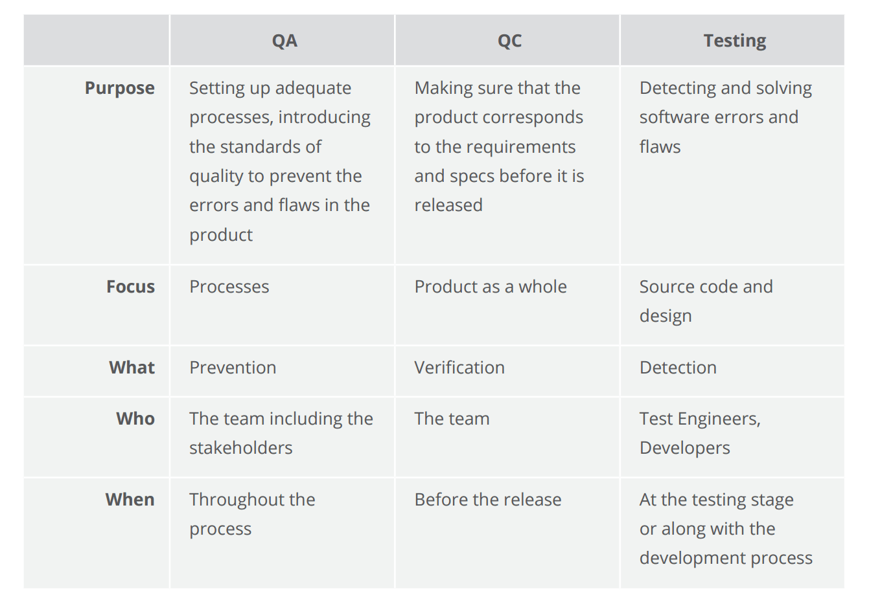
Verification
Validation

Slide 7
SQA Activities
Applying technical methods
To help the analyst achieve a high quality specification and a high quality design
Testing Software
A series of test case design methods that help ensure effective error detection
Enforcing standards
Measurement
Track software quality and assess the ability of methodological and procedural changes to improve software quality
Record keeping and reporting
Provide procedures for the collection and dissemination of SQA information

